Slide 1


Scientific Machine Learning
Lecture 6: Solving forward problems using PINNs
孟旭辉
数学与统计学院数学与应用学科交叉创新研究院
办公室：欣苑2栋111室
Email：xuhui_meng@hust.edu.cn
https://github.com/XuhuiM/SciML-Course
3/13/2023

Slide 2
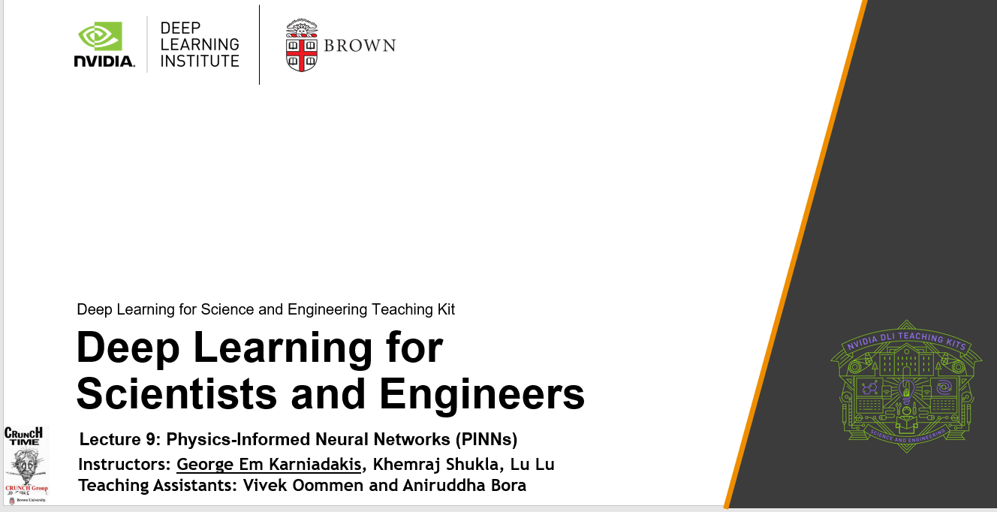

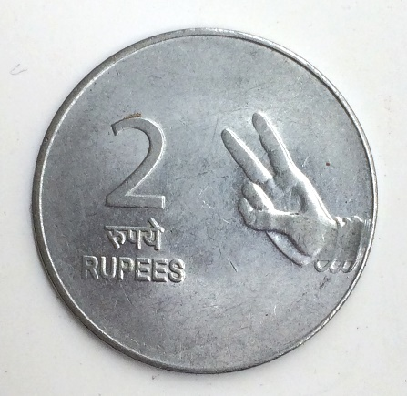
https://github.com/raj-brown/APMA2070
https://github.com/XuhuiM/APMA2070

Slide 3
Contents
Weighted loss functions
Topology optimization with physics constraint
Demo Codes for PINNs

Slide 4
Contents
Weighted loss functions
Topology optimization with physics constraint
Demo Codes for PINNs

Slide 5
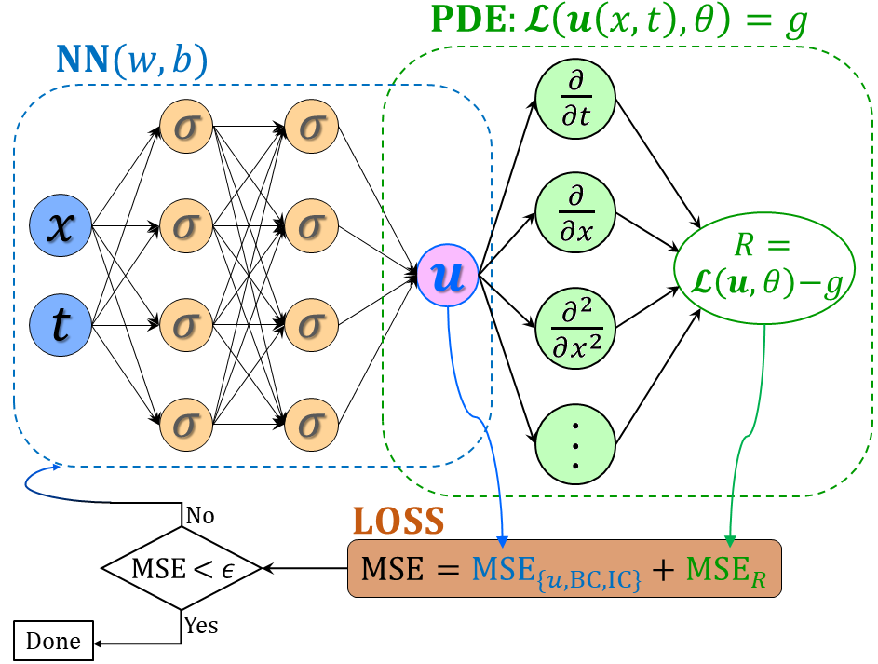
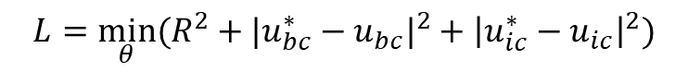
Weighted loss function
$$L={\min_{θ}⁡(R^{2}+|u_{bc}^{∗}−u_{bc}|}^{2}+{\left|u_{ic}^{∗}−u_{ic}\right|}^{2})$$
$$L={\min_{θ}⁡({w_{R}R}^{2}+w_{bc}|u_{bc}^{∗}−u_{bc}|}^{2}+w_{ic}{\left|u_{ic}^{∗}−u_{ic}\right|}^{2})$$

Slide 6
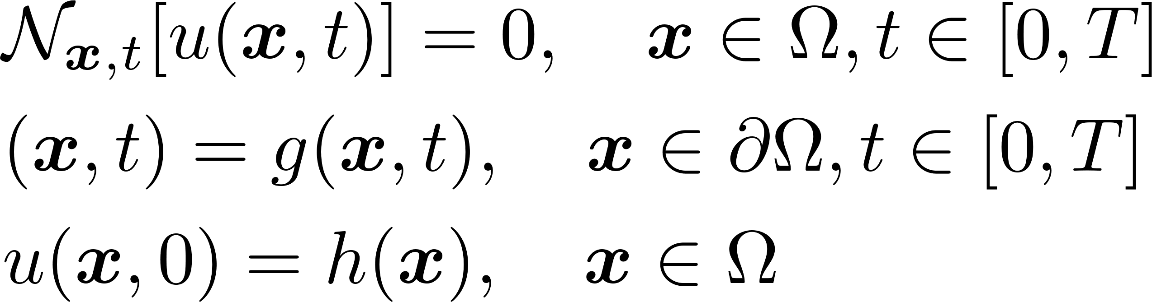

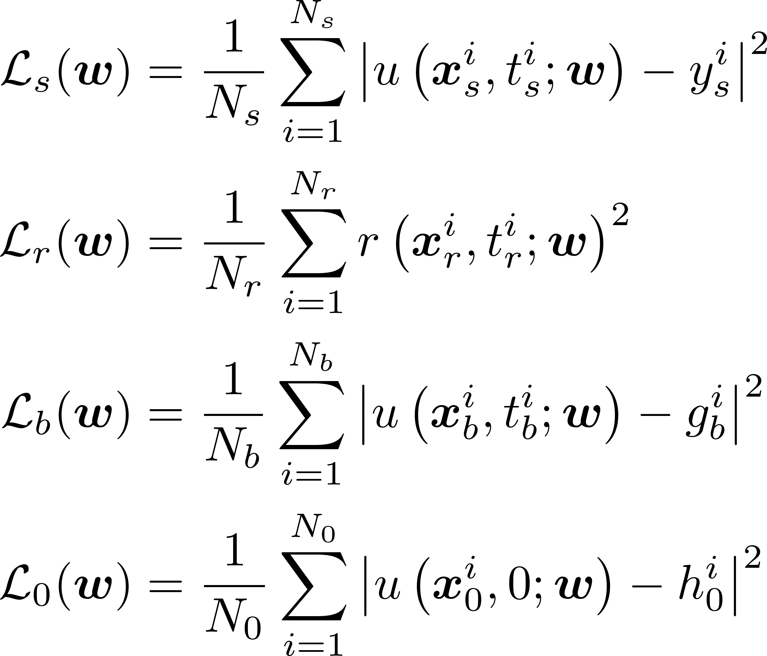
From PINN to self-adaptive PINNs
McClenny L, Braga-Neto U. Self-adaptive physics-informed neural networks using a soft attention mechanism. arXiv preprint arXiv:2009.04544. 2020.
gradient descent
gradient ascent

Slide 7
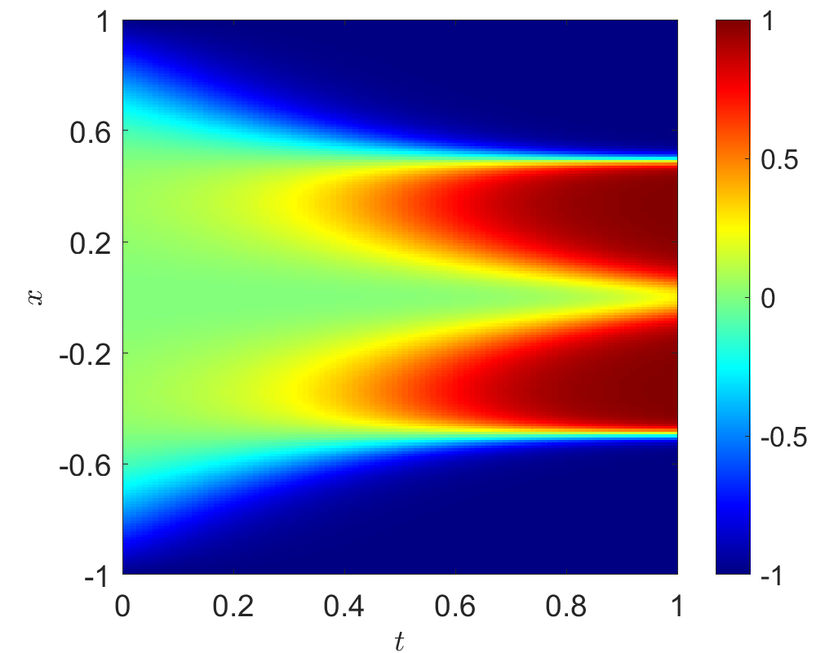
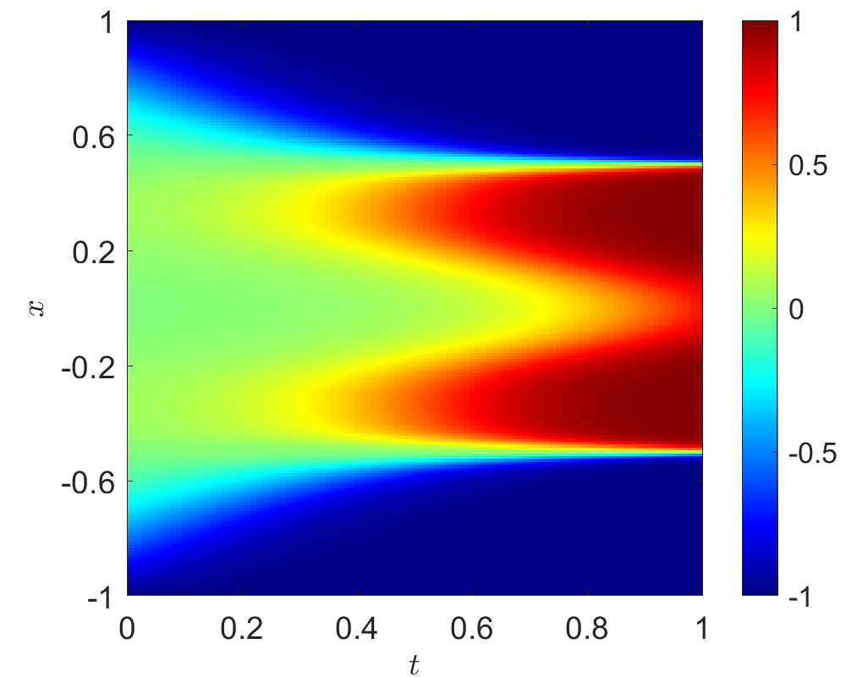
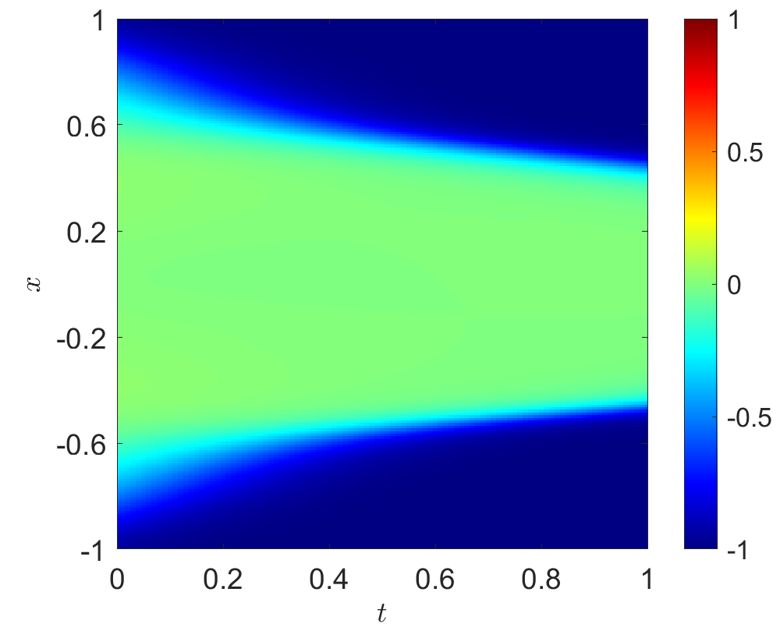
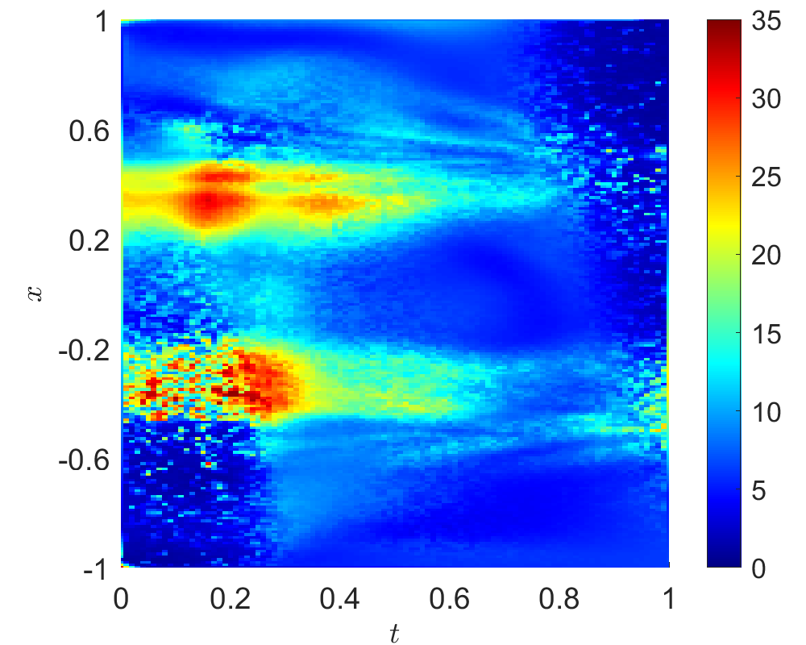
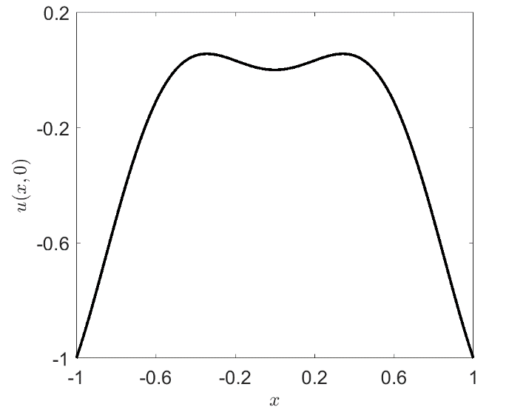
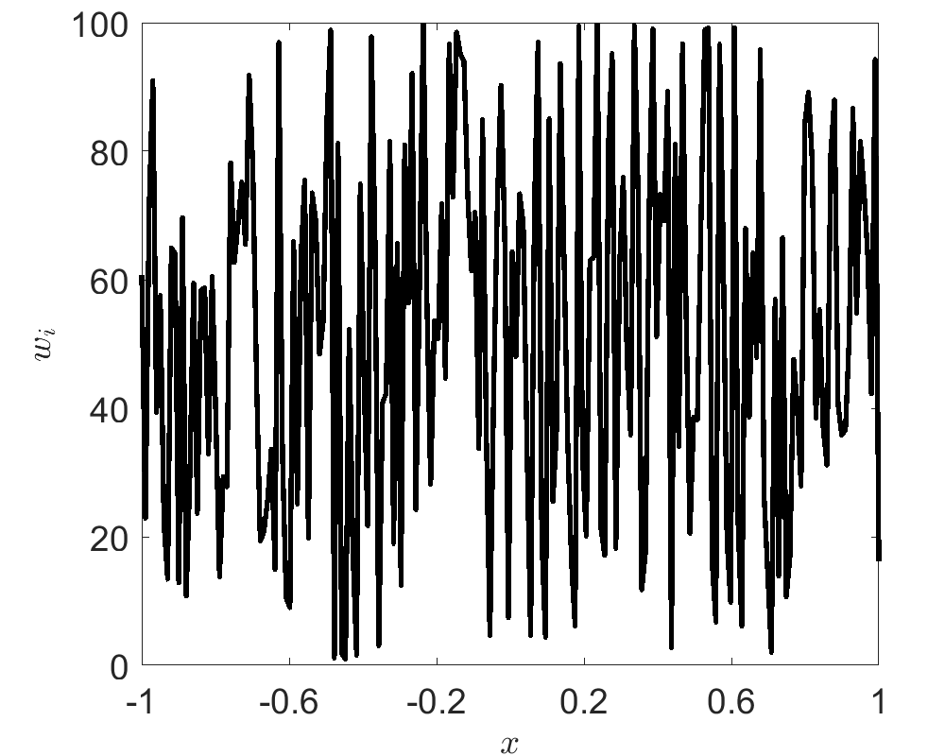
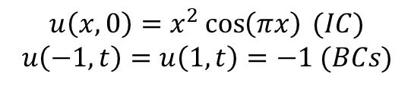
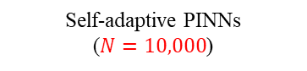
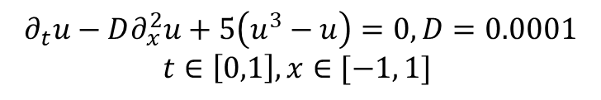
$$∂_{t}u−D∂_{x}^{2}u+5\left(u^{3}−u\right)=0, D=0.0001$$
$$t∈\left[0,1\right], x∈[−1, 1]$$
$$u\left(x,0\right)=x^{2}\cos\left(πx\right) (IC)$$
$$u\left(−1,t\right)=u\left(1,t\right)=−1 (BCs)$$
DNN: 4 hidden layers with 128 neurons per layer
20,000 random points for residual
200 uniform points for initial conditions
100 uniform points for boundary conditions
Reference solution
(Matlab pdetoolbox)
Self-adaptive PINNs
($N=10,000$)
Vanilla PINNs
Weights for residuals
Initial condition
Weights for initial condition

Slide 8
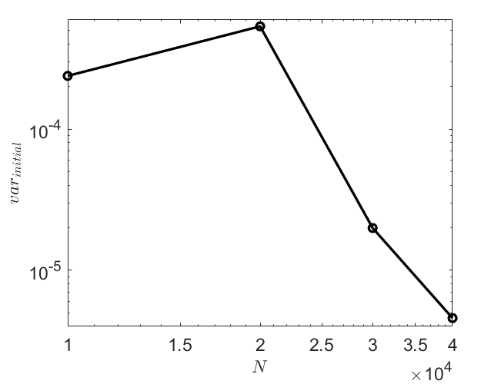
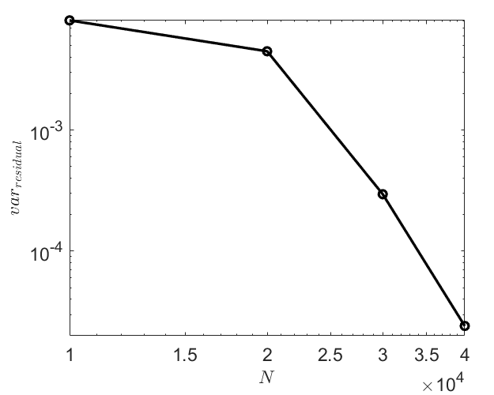
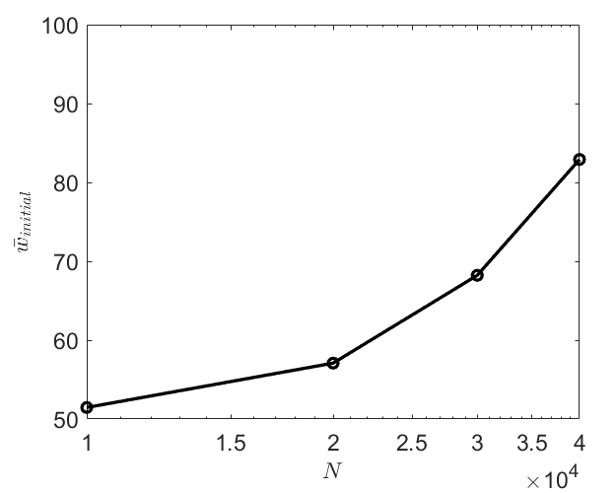
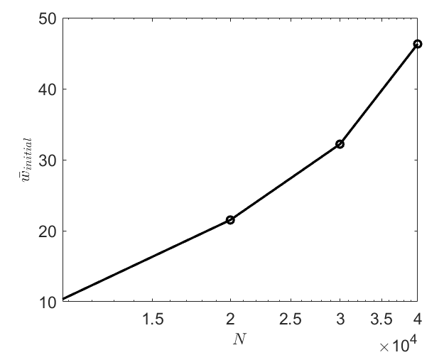
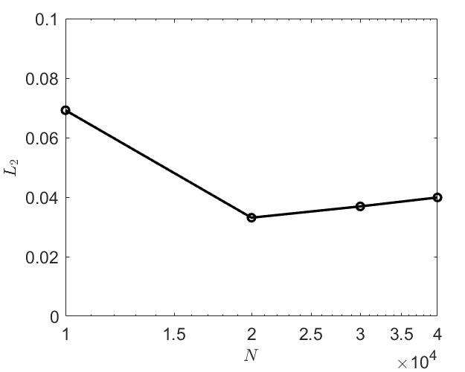
Variance for Losses
6.92%
3.69%
3.31%
3.91%

Slide 9
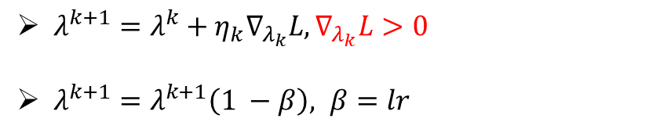
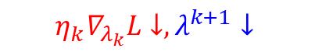
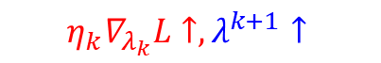
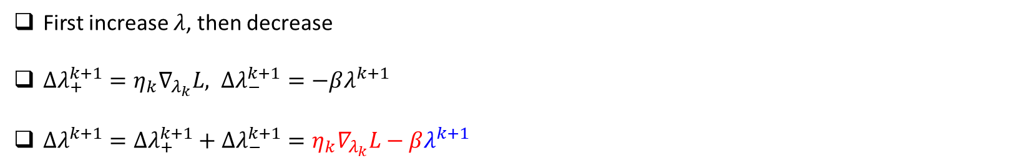
Variance for Losses: W’=W*(1-lr)
gradient ascent
$λ^{k+1}=λ^{k}+η_{k}∇_{λ_{k}}L, ∇_{λ_{k}}L>0$
$λ^{k+1}=λ^{k+1}\left(1 −β\right), β=lr$
First increase $λ$, then decrease
$Δλ_{+}^{k+1}=η_{k}∇_{λ_{k}}L, Δλ_{−}^{k+1}=−βλ^{k+1}$
$Δλ^{k+1}=Δλ_{+}^{k+1}+Δλ_{−}^{k+1}=η_{k}∇_{λ_{k}}L−βλ^{k+1}$
$$η_{k}∇_{λ_{k}}L↑, λ^{k+1}↑$$
$$η_{k}∇_{λ_{k}}L↓, λ^{k+1}↓$$
Learning rates are important!

Slide 10
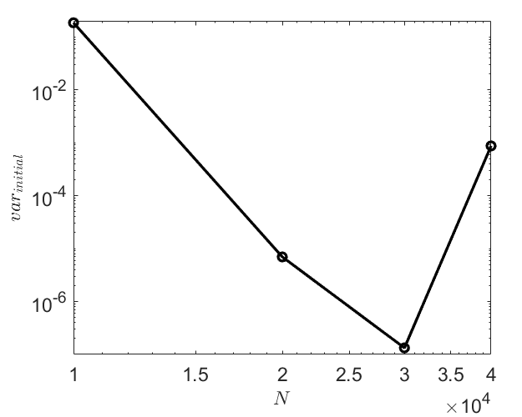
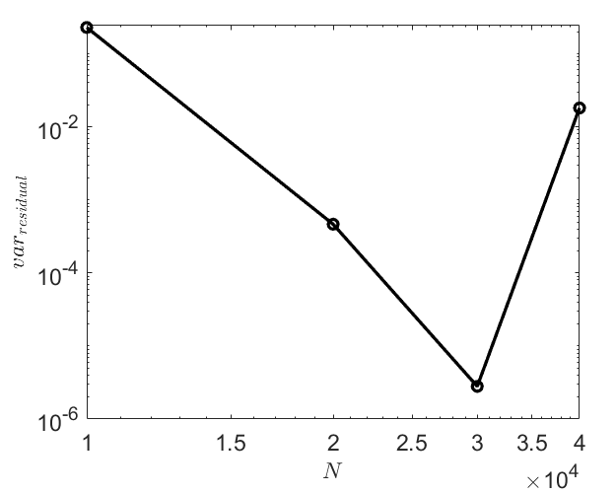
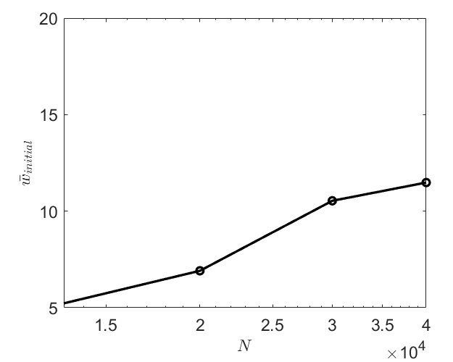
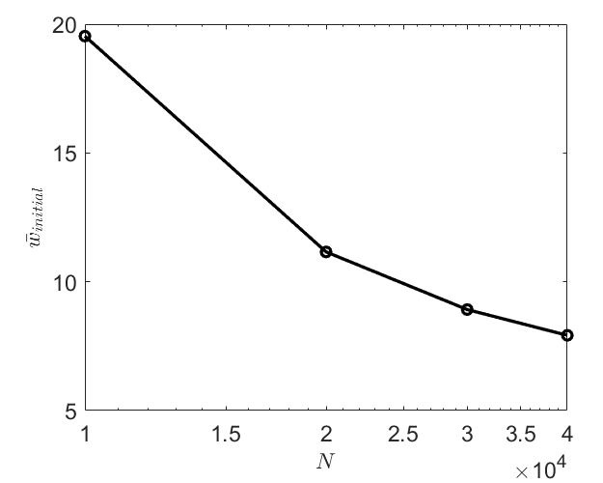
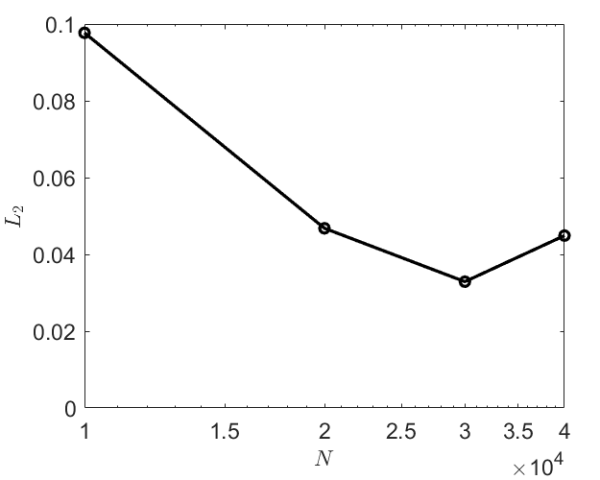
Variance for Losses: W’=W*(1-lr)
9.77%
4.68%
4.49%
3.29%

Slide 11

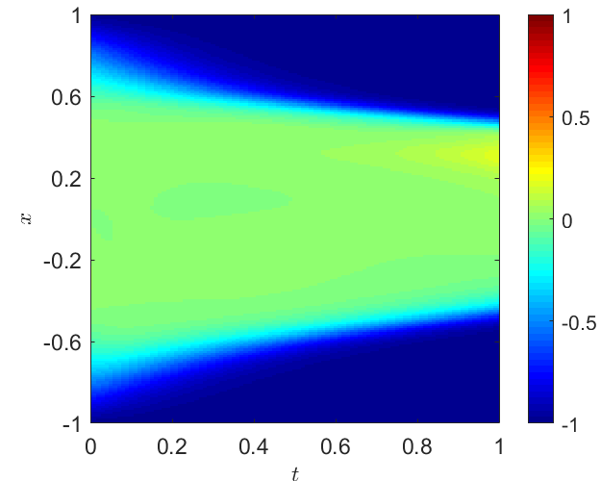
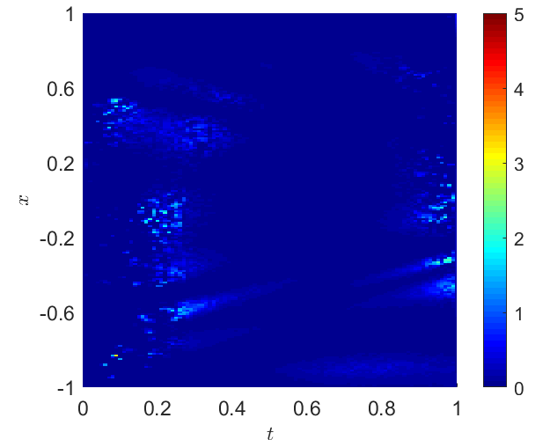
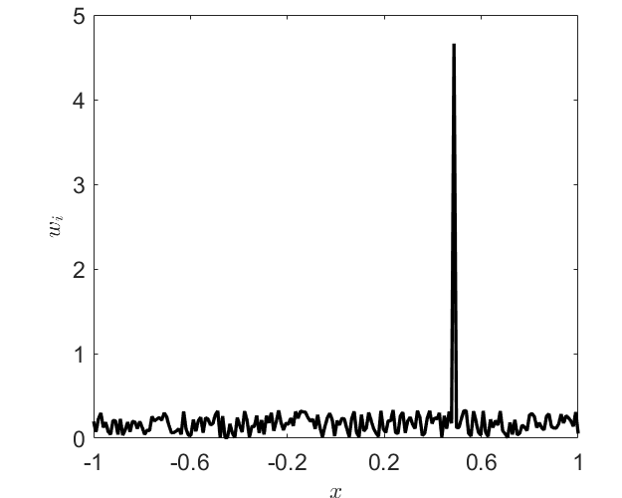
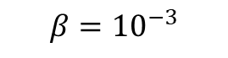

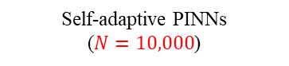
Variance for Losses: W’=W*(1-lr): Effect of learning rate
$λ^{k+1}=λ^{k}+η_{k}∇_{λ_{k}}L, ∇_{λ_{k}}L>0$
$λ^{k+1}=λ^{k+1}\left(1 −β\right), β=lr$
$$β={10}^{−3}$$
Reference solution
(Matlab pdetoolbox)
Self-adaptive PINNs
($N=10,000$)
Weights for residuals
Weights for initial condition

Slide 12
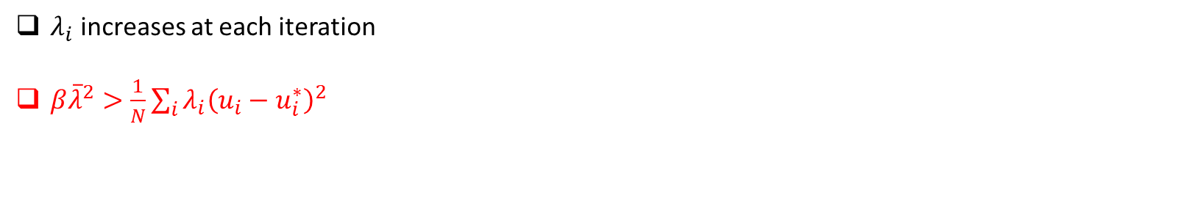
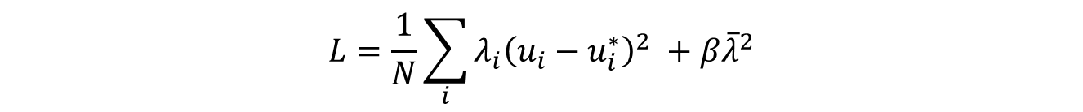
Constraint for the mean
$$L=\frac{1}{N}\sum_{i}{λ_{i}{\left(u_{i}−u_{i}^{∗}\right)}^{2} }+β{\overline{λ}}^{2}$$
L
$λ_{i}$ increases at each iteration
$β{\overline{λ}}^{2}>\frac{1}{N}\sum_{i}{λ_{i}{\left(u_{i}−u_{i}^{∗}\right)}^{2} }$
N

Slide 13
Different Self-adaptive PINNs
vanilla
weights increase at every step
vanilla
constraint for mean
prevent weights from increasing at every step
Self-adaptive PINNs
vanilla
w*(1-lr)
weights reach the equilibrium
after a certain number of iterations
DNN for weights
reduce memory usage

Slide 14
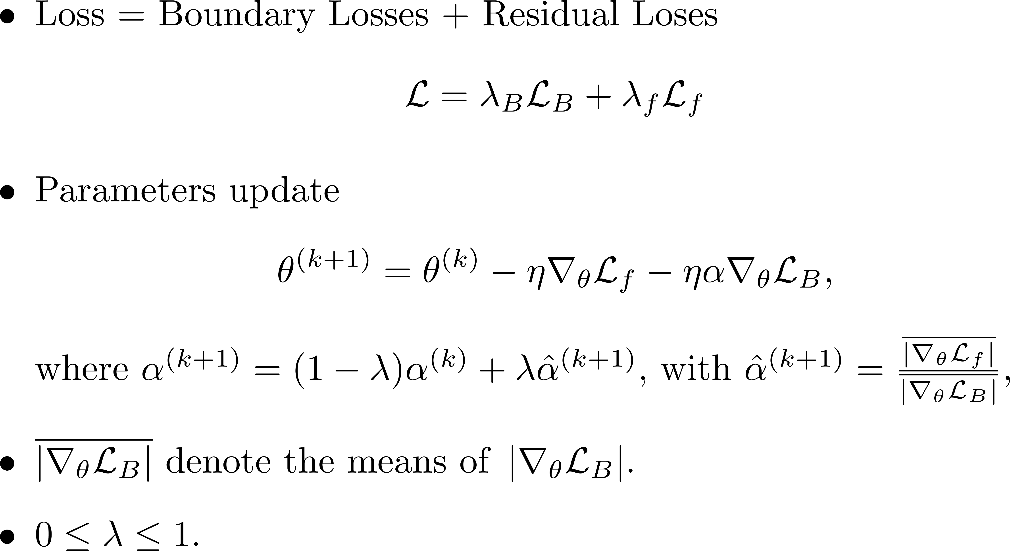
Dynamic weights for PINNs
Wang S, Yu X, Perdikaris P. When and why PINNs fail to train: A neural tangent kernel perspective. Journal of Computational Physics. 2022 Jan 15;449:110768.

Slide 15
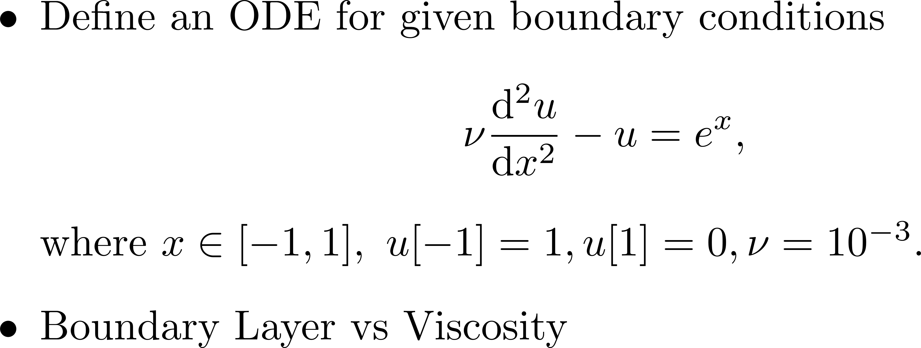
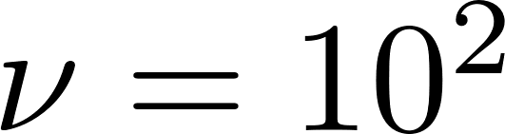
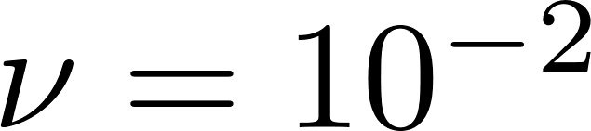
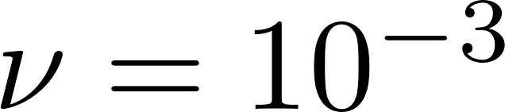
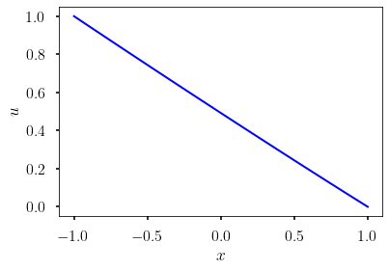
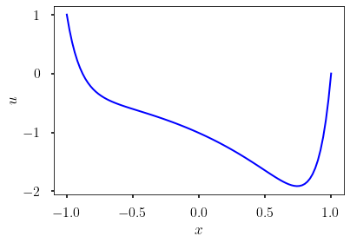
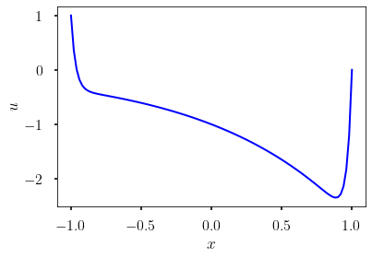
Dynamic weights for PINNs

Slide 16
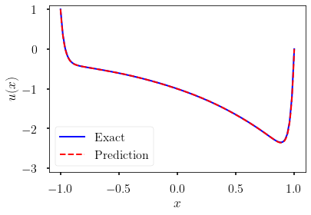
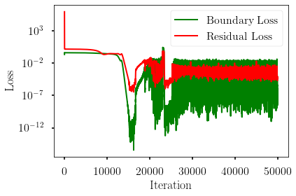
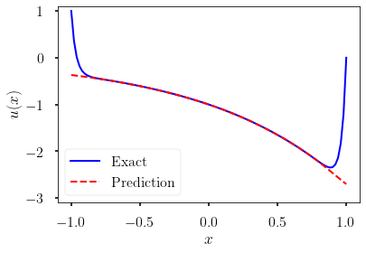
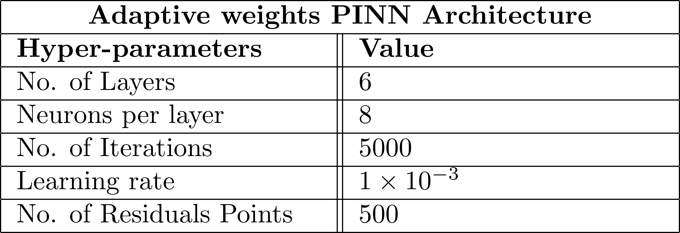
Dynamic weights for PINNs

Slide 17
Contents
Weighted loss functions
Topology optimization with physics constraint
Demo Codes for PINNs

Slide 18
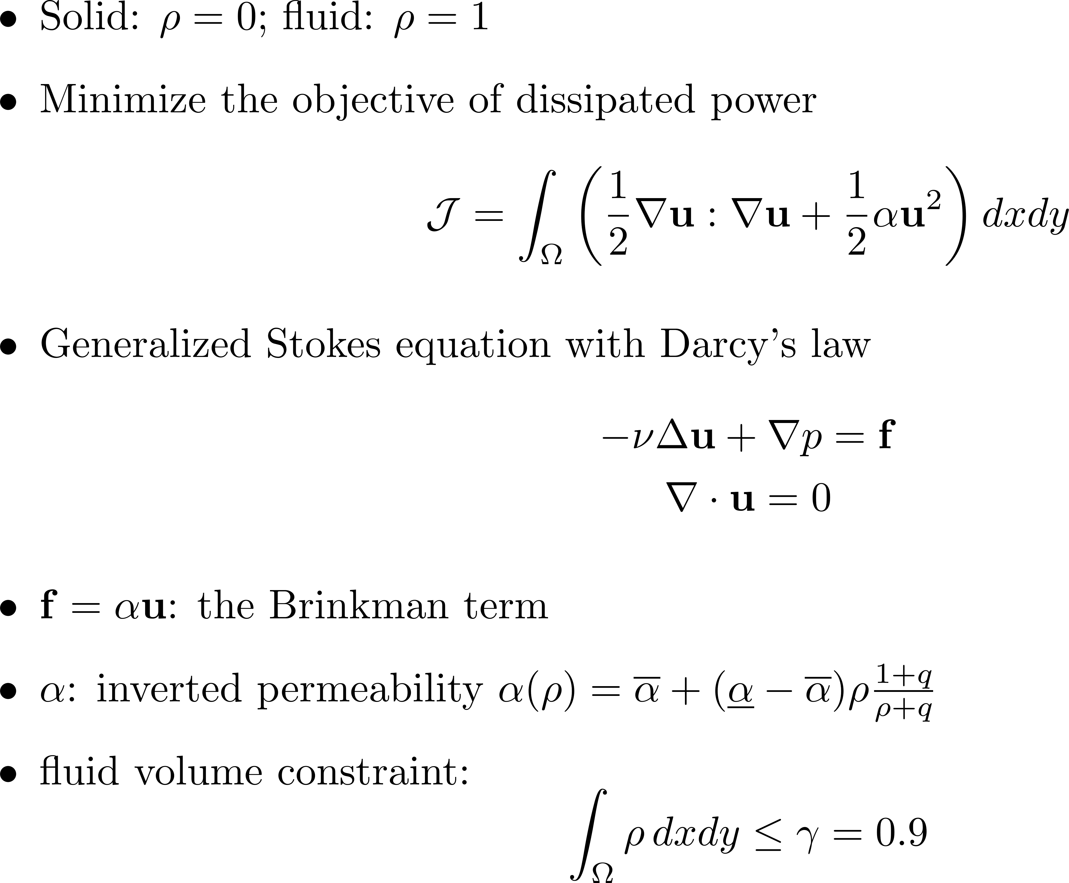
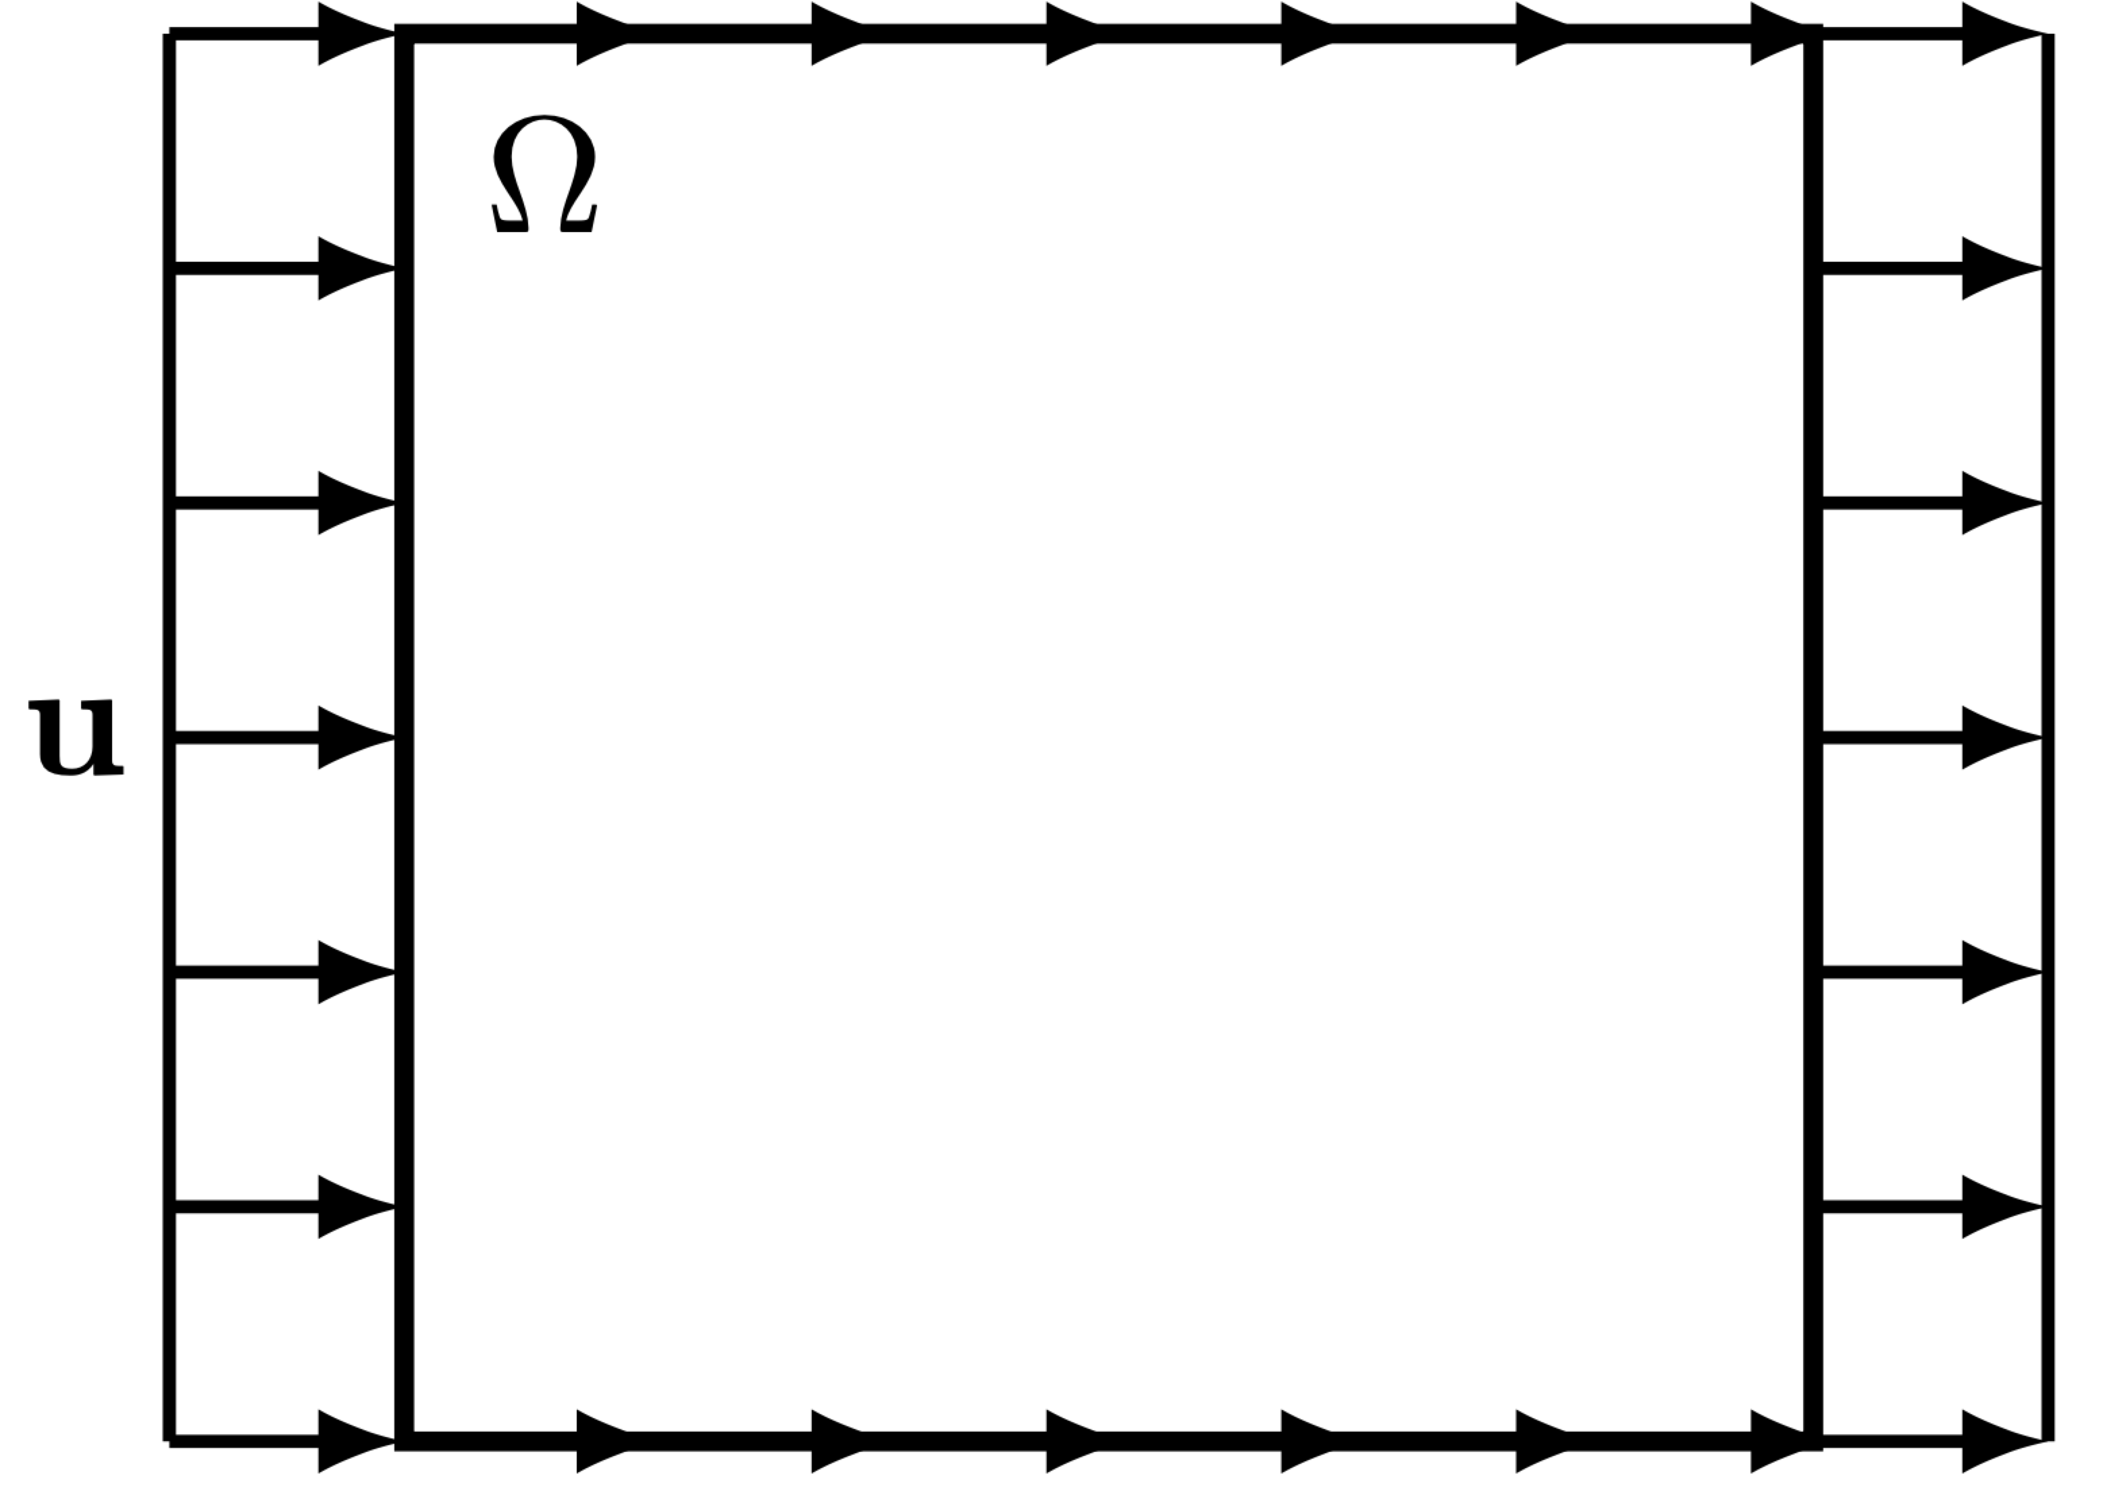
Topology optimization with physics constraint
Topology Optimization of Fluids in Stokes Flow
Lu L, Pestourie R, Yao W, Wang Z, Verdugo F, Johnson SG. Physics-informed neural networks with hard constraints for inverse design. SIAM Journal on Scientific Computing. 2021;43(6):B1105-32.

Slide 19




Topology optimization with physics constraint
Topology Optimization of Fluids in Stokes Flow

Slide 20


Topology optimization with physics constraint
Topology Optimization of Fluids in Stokes Flow
$$\max{h^{eq}}$$

Slide 21


Topology optimization with physics constraint
Topology Optimization of Fluids in Stokes Flow

Slide 22

Topology optimization with physics constraint
Topology Optimization of Fluids in Stokes Flow

Slide 23



Topology optimization with physics constraint
Topology Optimization of Fluids in Stokes Flow
$$A=0.1R$$

Slide 24
Contents
Weighted loss functions
Topology optimization with physics constraint
Demo Codes for PINNs

Slide 25

Codes for Burgers equation

Slide 26

Codes for Burgers equation

Slide 27

Codes for Burgers equation

Slide 28

Codes for Burgers equation

Slide 29
Codes for Burgers equation

Slide 30

Codes for Burgers equation

Slide 31
Codes for Self-adaptive PINNs

Slide 32


Codes for Self-adaptive PINNs

Slide 33

Codes for Self-adaptive PINNs
McClenny L, Braga-Neto U. Self-adaptive physics-informed neural networks using a soft attention mechanism. arXiv preprint arXiv:2009.04544. 2020 Sep 7.

Slide 34

Codes for Self-adaptive PINNs

Slide 35

Codes for Dynamic weight for PINNs

Slide 36


Codes for Dynamic weight for PINNs

Slide 37
Codes for Dynamic weight for PINNs

Slide 38

Thank you for your attention!

